Slide 1



Advanced Unit tests
Session
14
Chaim Turkel
Ido Barash

Slide 2


Last session – Unit tests
Testing in general
Unit-tests
JUnit

Slide 3
Advanced Unit tests
Advanced unit tests
Spring test
Using dependent layers
Test layers separately.
Mockito framework.
TDD.

Slide 4

Advanced Unit testing
The last session’s test cases (calculator) were very simple.
But what if we need to face something more realistic:

Slide 5
Advanced Unit testing
The last session’s test cases (calculator) were very simple.
But what if we need to face something more realistic:
Restful service
Business service
DB Handler
DB

Slide 6
Advanced Unit testing
The last session’s test cases (calculator) were very simple.
But what if we need to face something more realistic:
What about dependent layers?
Restful service
Business service
DB Handler
DB

Slide 7
Advanced Unit testing
The last session’s test cases (calculator) were very simple.
But what if we need to face something more realistic:
What about dependent layers?
Who will create them?
Are they part of the “unit” test?
Shouldn’t other layers have their own tests?
Restful service
Business service
DB Handler
DB

Slide 8
Advanced Unit testing
The last session’s test cases (calculator) were very simple.
But what if we need to face something more realistic:
We can:
Test both layers separately but use dependent layers.
Restful service
Business service
DB Handler
DB

Slide 9
Advanced Unit testing
The last session’s test cases (calculator) were very simple.
But what if we need to face something more realistic:
We can:
Test both layers separately but use dependent layers.
Test each layer separately using mocks of dependent layers.
Restful service
Business service
DB Handler
DB

Slide 10
Using the dependent layers
We will write different test classes for the both DB handler’s layer and business service layer.
DB handler test:
Check results from the DB by activating different parameters scenarios.
Business service test:
Check logic of the business service based on different parameters scenarios.
Check logic of the business service based on different DB results.
Restful service
Business service
DB Handler
DB

Slide 11
Using the dependent layers
We can instantiate the dependent beans on our own.
We can let Spring framework to instantiate beans and inject them to our test classes (recommended).
Restful service
Business service
DB Handler
DB

Slide 12
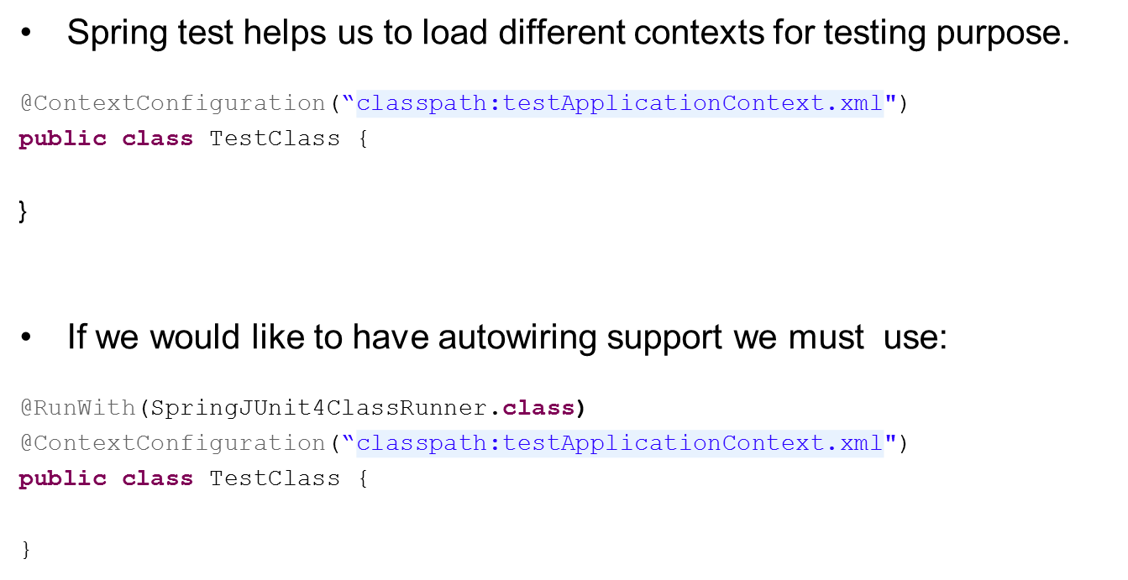
Spring test
Notes:
12

Slide 13
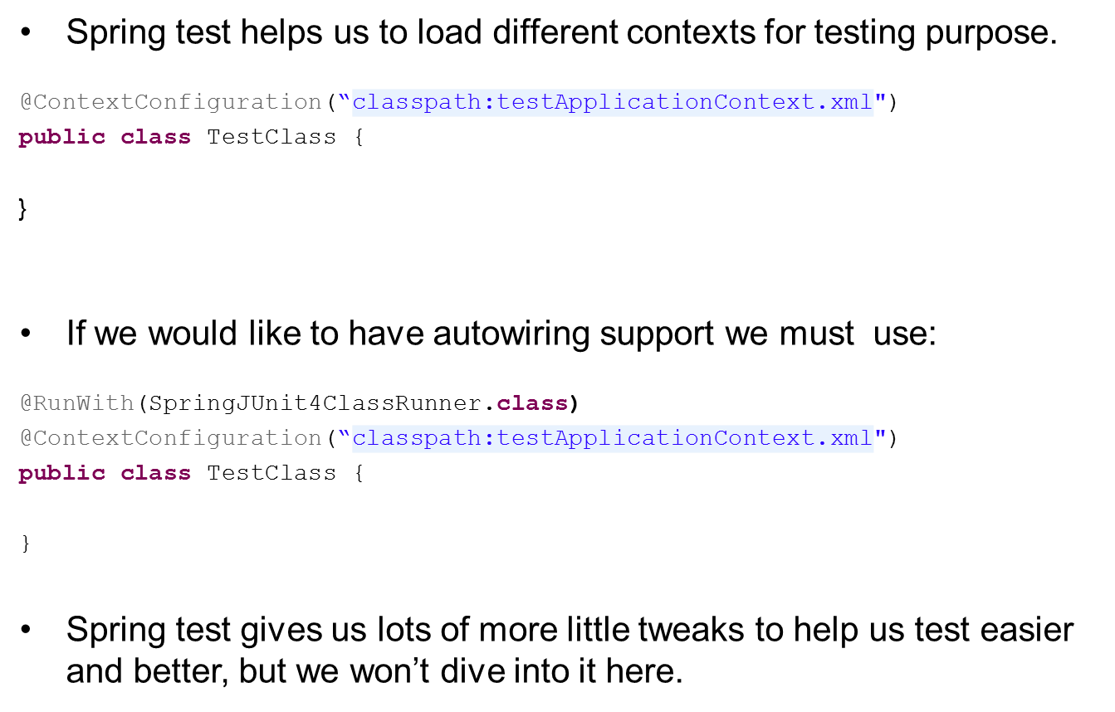
Spring test

Slide 14
Spring test
In order to use spring test and I’ts annotations we need to import it’s JAR using maven:
<dependency>
<groupId>org.springframework</groupId>
<artifactId>spring-test</artifactId>
<version>3.2.6.RELEASE</version>
</dependency>

Slide 15
Using the dependent layers
Since we will do actual DB operations during tests, such as load data, change data, etc… we must rollback all our changes.
Restful service
Business service
DB Handler
DB

Slide 16
Using the dependent layers
Example: @Autowired
private PolicyServices policyServices;
@Test
public void testFindPolicyByCriteria() throws SecurityException, UnsupportedEncodingException, NoSuchFieldException {
int maxResults = 10;
int firstResult = 0;
String orderBy = "id";
String criteria = "insuranceCompany=1&policyOperationalDatas.pProduct=456";
Collection<Policy> policies = policyServices.findPolicyByCriteria(maxResults, firstResult, orderBy, criteria, null, null, null);
Assert.assertNotNull(policies);
}

Slide 17
Using the dependent layers
Example: @Autowired
private PolicyServices policyServices;
@Test
public void testFindPolicyByCriteria() throws SecurityException, UnsupportedEncodingException, NoSuchFieldException {
int maxResults = 10;
int firstResult = 0;
String orderBy = "id";
String criteria = "insuranceCompany=1&policyOperationalDatas.pProduct=456";
Collection<Policy> policies = policyServices.findPolicyByCriteria(maxResults, firstResult, orderBy, criteria, null, null, null);
Assert.assertNotNull(policies);
}
Real Spring managed bean

Slide 18
Using the dependent layers
Example: @Autowired
private PolicyServices policyServices;
@Test
public void testFindPolicyByCriteria() throws SecurityException, UnsupportedEncodingException, NoSuchFieldException {
int maxResults = 10;
int firstResult = 0;
String orderBy = "id";
String criteria = "insuranceCompany=1&policyOperationalDatas.pProduct=456";
Collection<Policy> policies = policyServices.findPolicyByCriteria(maxResults, firstResult, orderBy, criteria, null, null, null);
Assert.assertNotNull(policies);
}
There will be a real DB call for real data

Slide 19
Using the dependent layers
This approach for unit testing requires true and updated data in the DB.
This makes tests very coupled with the DB.
This approach usually takes place with a very complicated model (when it’s hard to generate proper data on your own).
Tests can fail even if there is nothing wrong with the code (DB was changed, edited, etc…).
Tests are more accurate (Real data).
We also tests the correctness of the queries!

Slide 20
Using the dependent layers
Best practice:
Try generate the data needed for the test, insert it to the DB before the test and remove it from the DB after the test.
This way, the test will use the generated data, so it will not be coupled with existing data.
Sometimes, generating correct data will be difficult.
The “data generation” code will require maintenance.

Slide 21
Using the dependent layers
Exercise:
Use the library project.
Create a Test for the business service using all true beans of dependent layers.
Test the method addBook(Book book)
Make sure to put the test class under src/test/java section.
Make sure to put the test under the same packages hierarchy.

Slide 22
Using the dependent layers
Exercise – Solution
@Test
public void testAddBook() {
Book newBook = new Book();
newBook.setName("BBB");
booksService.addBook(newBook);
Collection<Book> allBooks = booksService.getAllBooks();
Assert.assertNotNull(allBooks);
boolean found = false;
for (Book currentBook : allBooks) {
if (currentBook.getName().equals(newBook.getName())) {
found = true;
}
}
Assert.assertTrue(found);
{

Slide 23
Test layers separately
This approach for unit testing believes that unit testing should only test their own unit’s logic code.
All dependent beans should not be considered.
Instead, the tests should handle all possible results from the various dependent bean calls.
Restful service
Business service
DB Handler
DB

Slide 24
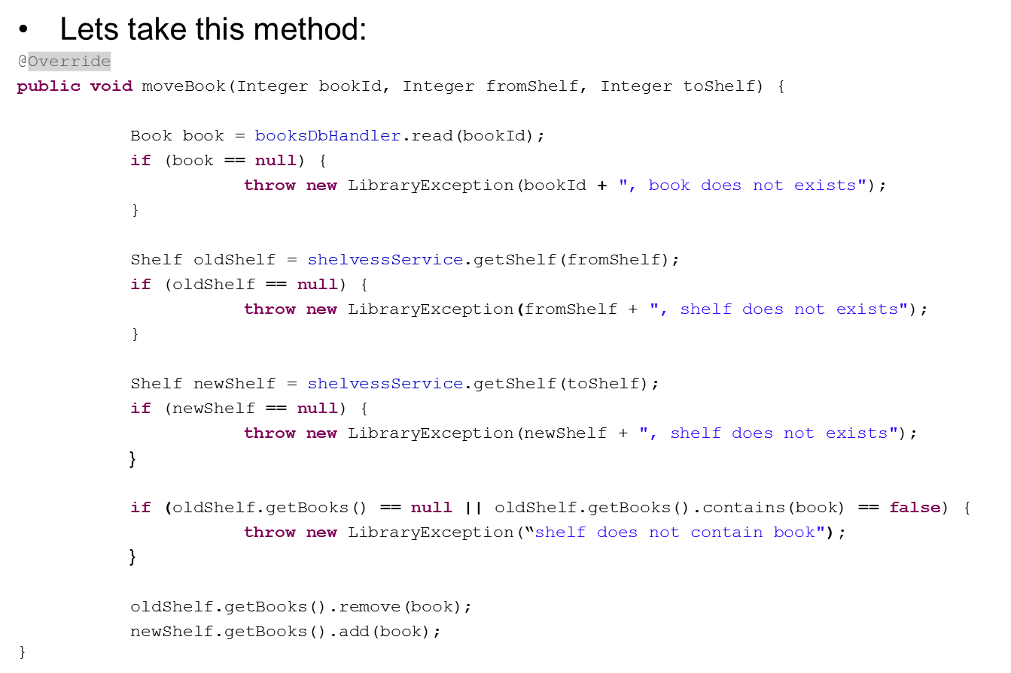
Test layers separately

Slide 25
Test layers separately
We will create a generated result for each dependent bean method invocation, according to the scenario we wish to test.
This result is like a “white-box” .
This operation (returning a preconfigured white-box) is called Mocking.
For mocking purpose we can create a new implementation for each interface, and then override methods to generate and return the white-box data. This implementation is called STUB.
Or we can use a mocking framework such as Mockito.

Slide 26
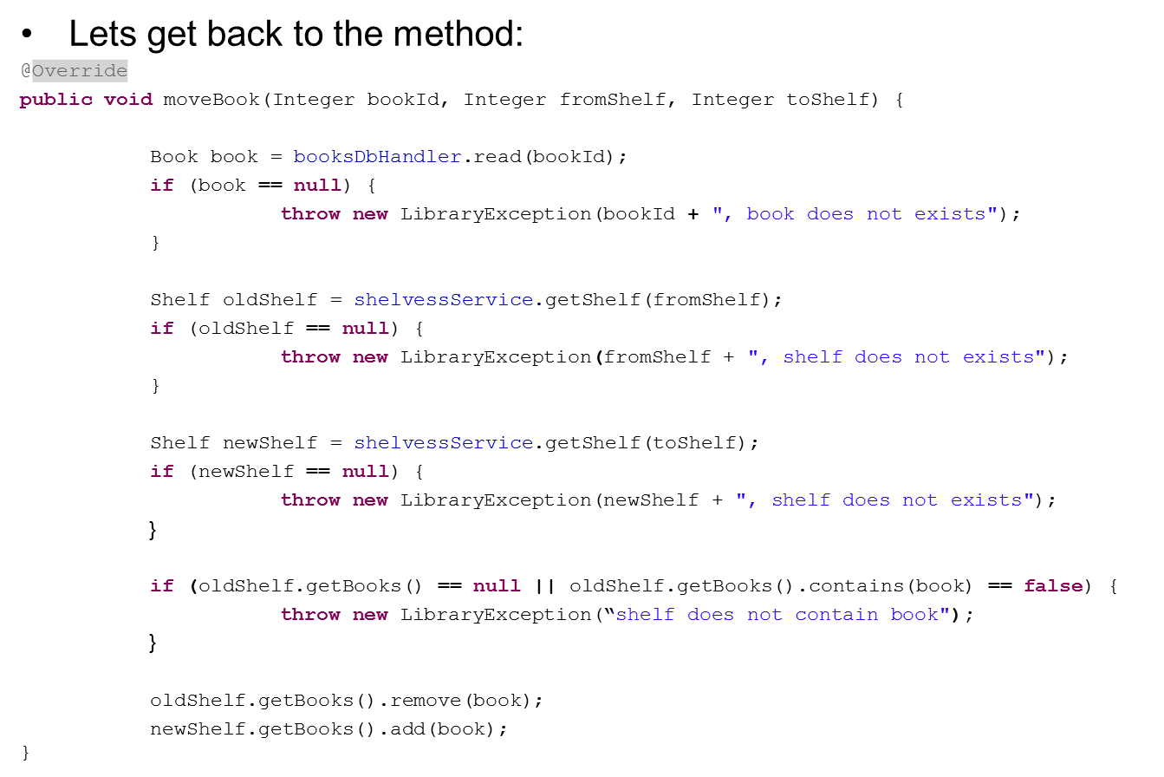
Test layers separately

Slide 27
Test layers separately
Should be Mocked!

Slide 28
Test layers separately
Normal method flow:
Method
BooksDbHandler
ShelvesService
ShelvesService
ShelvesDbHandler
DB

Slide 29
Test layers separately
Normal method flow:
Method
BooksDbHandler
ShelvesService
ShelvesService
ShelvesDbHandler
DB

Slide 30
Test layers separately
Normal method flow:
Method
BooksDbHandler
ShelvesService
ShelvesService
ShelvesDbHandler
DB

Slide 31
Test layers separately
Normal method flow:
Method
BooksDbHandler
ShelvesService
ShelvesService
ShelvesDbHandler
DB

Slide 32
Test layers separately
Mocked method flow:
Method
Mock
BooksDbHandler
Mock
ShelvesService
Mock
ShelvesService
ShelvesDbHandler
DB

Slide 33
Test layers separately
Mocked method flow:
Method
Mock
BooksDbHandler
Mock
ShelvesService
Mock
ShelvesService
ShelvesDbHandler
DB

Slide 34
Test layers separately
Mocked method flow:
Method
Mock
BooksDbHandler
Mock
ShelvesService
Mock
ShelvesService
ShelvesDbHandler
DB

Slide 35
Test layers separately
Mocked method flow:
Method
Mock
BooksDbHandler
Mock
ShelvesService
Mock
ShelvesService
ShelvesDbHandler
DB

Slide 36
Test layers separately
The layers are now completely isolated.
This approach validates logic code only.
If we generated the mocks correctly, each method should have several tests confirming all possible scenarios.
This is quite difficult to achieve with a very complicated data model.
This approach does not test DB calls or queries.

Slide 37
Mockito
Mockito is a framework that dynamically generates a Mock object.
Using a simple API, we can tell Mockito what generated result should it return on a specific method call.
First we need to import Mockito JAR using maven:
<dependency>
<groupId>org.mockito</groupId>
<artifactId>mockito-all</artifactId>
<version>1.9.5</version>
</dependency>

Slide 38
Mockito
Now we can declare mocks as private members.
@Mock
private BooksDbHandler booksDbHandlerMock;
Or create mocks on runtime:
BooksDbHandler booksDbHandlerMock = Mockito.mock(BooksDbHandler.class);
** if you use annotations you must initiate mocks on test setup:
@Before
public void init() {
MockitoAnnotations.initMocks(this);
}

Slide 39
Mockito
Using the mock, we can setup a prepared result and tell the mock object when to return it to us.
Mockito.when(booksDbHandlerMock.read(5)).thenReturn(new Book(5,"AAA"));

Slide 40
Mockito
Using the mock, we can setup a prepared result and tell the mock object when to return it to us.
Mockito.when(booksDbHandlerMock.read(5)).thenReturn(new Book(5,"AAA"));
When ever the DbHandler-mock’s “read” method will be invoked with the parameter “5”.

Slide 41
Mockito
Using the mock, we can setup a prepared result and tell the mock object when to return it to us.
Mockito.when(booksDbHandlerMock.read(5)).thenReturn(new Book(5,"AAA"));
the Mock will generate this new book and return it.

Slide 42
Mockito
Using the mock, we can setup a prepared result and tell the mock object when to return it to us.
Mockito.when(booksDbHandlerMock.read(5)).thenReturn(new Book(5,"AAA"));
the Mock will generate this new book and return it.
NO DB call!

Slide 43
Mockito
In order to use the mocks, they must be injected to the service we are testing. This code:
Mockito.when(booksDbHandlerMock.read(5)).thenReturn(new Book(5,"AAA"));
Will mean nothing if eventually the tested service use Spring managed “real bean”, instead of the mock.

Slide 44
Mockito
We can set the mock using a normal setter method: @Resource private BooksBusinessService booksService;
@Mock
private BooksDbHandler booksDbHandlerMock;
@Test
public void testAddBook() {
((BooksDbHandlerImpl)booksService).setBooksDbHandler(booksDbHandlerMock);
This way we override the bean injected by Spring with the mock we created.

Slide 45
Mockito
We can set the mock using a normal setter method: @Resource private BooksBusinessService booksService;
@Mock
private BooksDbHandler booksDbHandlerMock;
@Test
public void testAddBook() {
((BooksDbHandlerImpl)booksService).setBooksDbHandler(booksDbHandlerMock);
This way we override the bean injected by Spring with the mock we created.

Slide 46
Mockito
Or we can let Mockito override the tested service beans using Mockito’s @InjectMocks annotation:
@Resource
@InjectMocks
private BooksBusinessService booksService;
@Mock
private BooksDbHandler booksDbHandlerMock;
@Before
public void init() {
MockitoAnnotations.initMocks(this);
}

Slide 47
Mockito
Or we can let Mockito override the tested service beans using Mockito’s @InjectMocks annotation:
@Resource
@InjectMocks
private BooksBusinessService booksService;
@Mock
private BooksDbHandler booksDbHandlerMock;
@Before
public void init() {
MockitoAnnotations.initMocks(this);
}

Slide 48
Mockito
Or we can let Mockito override the tested service beans using Mockito’s @InjectMocks annotation:
@Resource
@InjectMocks
private BooksBusinessService booksService;
@Mock
private BooksDbHandler booksDbHandlerMock;
@Before
public void init() {
MockitoAnnotations.initMocks(this);
} When the initMock() method runs, Mockito will find beans annotated with @InjectMocks, and use Reflection API to set the properties with generated mocks.

Slide 49
Mockito
Exercise:
Using Mockito, test the logics of moving book from shelf to another shelf logic. The method moveBook() of Books Business service.

Slide 50
Mockito
Exercise: Solution
@Resource
@InjectMocks
private BooksBusinessService booksService;
@Mock
private BooksDbHandler booksDbHandlerMock;
@Mock
private ShelvesBusinessService shelvesBusinessServiceMock;
@Before
public void init() {
MockitoAnnotations.initMocks(this);
{

Slide 51
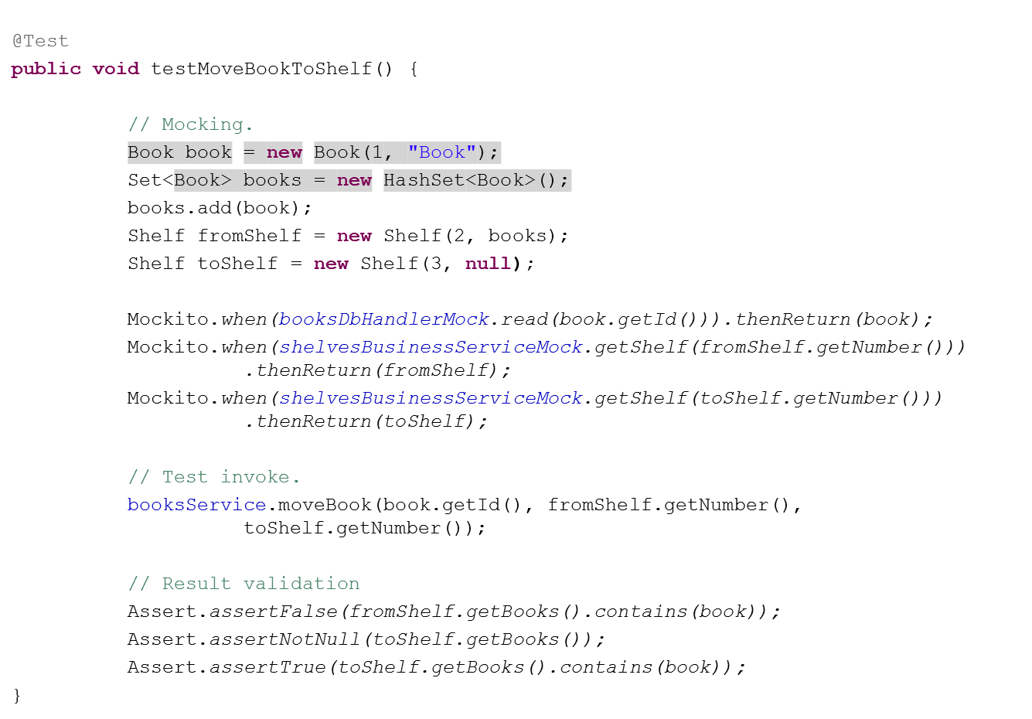
Mockito

Slide 52
TDD
TDD: Test Driven Development :
Development methodology.
Normally, We write the class logics and then create tests that usually fits the way we wrote the code.
TDD says it is wrong. The goal of test is not to “fit” the code, but to validate the outcome. It should make sure that the code does what it should.
On TDD, first we write the test itself, then write the code.
First we’ll have to consider the possible scenarios and all the problems, and only then we’ll start coding.

Slide 53
TDD
Developing in TDD means iterations:
Create the real class
Create Class

Slide 54
TDD
Developing in TDD means iterations:
Create the Test class
Create Class
Create TestClass

Slide 55
TDD
Developing in TDD means iterations:
First, without writing a single line of logic in your class, Create test.
Create Class
Create TestClass
Create Test

Slide 56
TDD
Developing in TDD means iterations:
There will be compilation errors – fix them by adding the methods on properties to the real class.
Create Class
Create TestClass
Create Test
Compilation Error
Create real method

Slide 57
TDD
Developing in TDD means iterations:
Run the test.
Create Class
Create TestClass
Create Test
Run Test
Compilation Error
Create real method

Slide 58
TDD
Developing in TDD means iterations:
Run the Test – it should fail since there is no logic.
Create Class
Create TestClass
Create Test
Run Test
Compilation Error
Test fail
Create real method

Slide 59
TDD
Developing in TDD means iterations:
Fix method (write method logic).
Create Class
Create TestClass
Create Test
Run Test
Compilation Error
Test fail
Create real method
Fix method

Slide 60
TDD
Developing in TDD means iterations:
Fix your code and then run again. Iterate– run the test and fix it until the test passes.
Create Class
Create TestClass
Create Test
Run Test
Compilation Error
Test fail
Create real method
Fix method

Slide 61
TDD
Developing in TDD means iterations:
Test succeeded: continue and write the next test.
Create Class
Create TestClass
Create Test
Run Test
Compilation Error
Test fail
Create real method
Fix method
Test Succeed

Slide 62
Overview - Advanced Unit tests
Advanced unit tests
Spring test
Using dependent layers
Test layers separately.
Mockito framework.
TDD.

Slide 63


THANK YOU
Ido Barash
Email: ido.barash@tikalk.com

